Slide 1
Unit Testing
Verifying your works

Slide 2
Today’s goal
Verify the business logic of the system
Systematically
Automatically

Slide 3
Agenda
V-model
What is a unit test
What is JUnit6
What is a good unit test?
F.I.R.S.T.
Naming conventions
AAA
Black/white box testing
Testing strategies
ZOMBIES
Boundary Value Analysis
Equivalence partitioning
How to test logic
Service classes
Mocking dependencies
Assignment

Slide 4
Testing overview
V-model

Slide 5
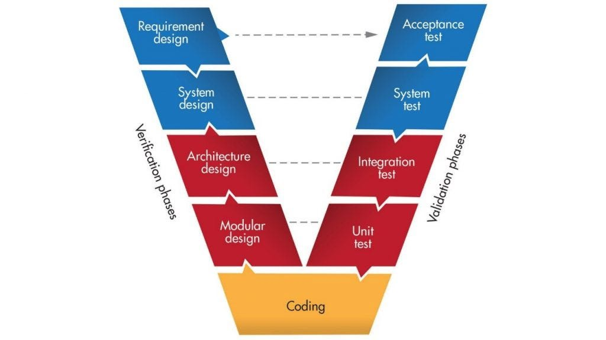

Testing V-Model

Slide 6
Testing V-Model
Scenario
Testing
Requirements
Architecture
Design
Integration
Testing
Modular
Design
Unit
Testing
Verification
Validation
Are we building the product correct?
Does it work as expected?
Coding

Slide 7
Testing V-Model
Scenario
Testing
Requirements
Architecture
Design
Integration
Testing
Modular
Design
Unit
Testing
Verification
Validation
Are we building the product correct?
Does it work as expected?
Coding

Slide 8
Agenda
V-model
What is a unit test
What is JUnit6
What is a good unit test?
F.I.R.S.T.
Naming conventions
AAA
Black/white box testing
Testing strategies
ZOMBIES
Boundary Value Analysis
Equivalence partitioning
How to test logic
Service classes
Mocking dependencies
Assignment

Slide 9
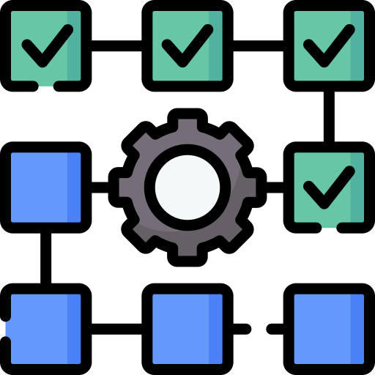

What is a unit test?

Slide 10
What is a unit test?
A test that verifies a (small) “unit of behaviour”
public class Calculator { public static int add(int a, int b) { return a + b; } }
public static void main(String[] args) { int inputA = 3; int inputB = 4; int expected = 7;
int result = Calculator.add(inputA, inputB); String message = expected == result
? "Success"
: "Failure"; System.out.println(message); }
A “unit” is often the behaviour of a single method

Slide 11

What is a unit?
Unit
Unit
Test
Test
Test
?
Presentation
Logic
Persistence

Slide 12
What is a unit test
1.
Verifies a small ”piece” of code (the unit) of cohesive behaviour.
Unit
Unit
Test
Test

Slide 13



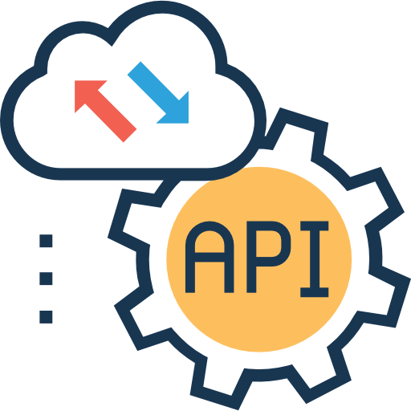




What is a unit test
2.
Does it in an isolated manner
Don’t reach out of the system

Slide 14
Unit Test: A fast, automated check of a single path of logic.
It is isolated, meaning it doesn't touch the "outside world" (databases, files, or networks) and it doesn't care about other tests.
If it fails, you know exactly which function is broken.

Slide 15
Agenda
V-model
What is a unit test
What is JUnit6
What is a good unit test?
F.I.R.S.T.
Naming conventions
AAA
Black/white box testing
Testing strategies
ZOMBIES
Boundary Value Analysis
Equivalence partitioning
How to test logic
Service classes
Mocking dependencies
Assignment

Slide 16
Automated?
public static void main(String[] args) { int inputA = 3; int inputB = 4; int expected = 7;
int result = Calculator.add(inputA, inputB); String message = expected == result
? "Success"
: "Failure"; System.out.println(message); }
No
Either
Verifying many things in one main method, sequentially
Or
Many main methods
Neither is good

Slide 17

What is JUnit?

Slide 18
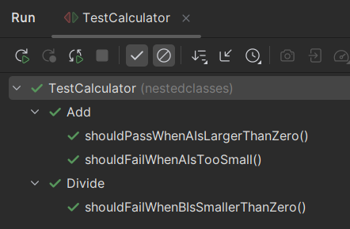
What is JUnit
public class CalculatorTest { @Test void shouldAddTwoNumbers() { int result = Calculator.add(2,2); assertEquals(4, result); } }
A testing tool
It allows us to write small test methods
Bunch of fancy tooling
Read the learning path

Slide 19
Agenda
V-model
What is a unit test
What is JUnit6
What is a good unit test?
F.I.R.S.T.
Naming conventions
AAA
Black/white box testing
Testing strategies
ZOMBIES
Boundary Value Analysis
Equivalence partitioning
How to test logic
Service classes
Mocking dependencies
Assignment

Slide 20

What is a good unit test?

Slide 21
What is a good unit test
public class CalculatorTest { @Test void whatever() { int result = Calculator.add(2,2); } }

Slide 22

F.I.R.S.T.
What is a good unit test
Principle

Slide 23





Fast: Tests should run in milliseconds so developers actually run them.
Independent/Isolated: One test should not depend on the output of another. Tests can be run in any order.
Repeatable: Results must be the same every time, regardless of the environment.
Self-Validating: The test should have a clear pass/fail result (no manual log checking).
Thorough/Timely: Cover edge cases, and ideally be written alongside the code (TDD).

Slide 24

Naming conventions
What is a good unit test

Slide 25
Naming conventions
What is a good unit test
The name of the test should clearly indicate:
What is being tested
What the situation is
What the expected outcome is
Clear naming will make everything easier
See learning path about naming conventions
Bad Name (Lazy) | Better Name (Professional) | Why it's better
test_add() | add_twoPositiveNumbers_returnsSum | Specifies the input and the result.
test_user() | user_invalidAge_isNotSaved | Explains the "Scenario" being blocked.
test_api() | fetchData_networkError_returnsNull | Tells you exactly what "Isolation" was mocked.
test_logic_final() | discount_goldMember_applies20Percent | It's descriptive and avoids "vague-booking."

Slide 26

Pattern

Slide 27
AAA pattern
A unit test commonly has three parts:
Arrange (setup)
Act (execute)
Assert (verify)
Read the learning path for more information
public static void main(String[] args) { int inputA = 3; int inputB = 4; int expected = 7;
int result = Calculator.add(inputA, inputB); String message = expected == result
? "Success"
: "Failure"; System.out.println(message); }

Slide 28
Black box vs White box

Slide 29


Black box vs White box
Black Box Testing
Define tests based on specified behaviour
No looking at code
Give input → verify output
White Box Testing
Define tests based implementation details
Looking at code can give extra information
Ensure all paths through code is covered
Read the learning path

Slide 30
Agenda
V-model
What is a unit test
What is JUnit6
What is a good unit test?
F.I.R.S.T.
Naming conventions
AAA
Black/white box testing
Testing strategies
ZOMBIES
Boundary Value Analysis
Equivalence partitioning
How to test logic
Service classes
Mocking dependencies
Assignment

Slide 31

Testing strategies

Slide 32
Testing strategies
We want to design test cases to cover as much of the code/behaviour as possible.
Several theories help us define these strategies:
ZOMBIES
Boundary Value Analysis
Equivalence partitioning

Slide 33

ZOMBIES

Slide 34
ZOMBIES
Which cases to cover
How to design tests
Z ero
Consider NULL or 0 or “” or “nothing”, whatever that is
O ne
Just a single whatever, or 1, or something
M any (more complex)
What happens if you have more than 1. Many
B oundary behaviours
Testing boundaries. Behaviour changes at boundaries
I nterfaces
Test against public methods, the interface of your unit of behavior
E xceptions
Consider failure scenarios, not only happy paths
S
imple scenarios
imple solutions
Keep your tests simple. Don’t do multiple acts, minimize the number of asserts.

Slide 35
Boundary value analysis Equivalence partitioning

Slide 36
Ranges
Your system changes behaviour at ”boundaries”
Valid input: [1, 100]
What happens if input is 0?
What happens if input is 1?
What happens if input is 100?
What happens if input is 101?
1
100
Change in behaviour
Change in behaviour

Slide 37
Ranges
Do I need test cases to cover all input between 2 and 99?
1
100
Change in behaviour
Change in behaviour

Slide 38
Ranges
Select a few representatives from each ”partition”
Behaviour within a partition should be the same
1
100
Change in behaviour
Change in behaviour

Slide 39
Read more about this in learning paths:
Boundary Value Analysis
Equivalence Partitioning

Slide 40
Agenda
V-model
What is a unit test
What is JUnit6
What is a good unit test?
F.I.R.S.T.
Naming conventions
AAA
Black/white box testing
Testing strategies
ZOMBIES
Boundary Value Analysis
Equivalence partitioning
How to test logic
Service classes
Mocking dependencies
Assignment

Slide 41
Testing Services

Slide 42
Testing the logic
Your service classes contains, or executes, the logic of the system
It makes sense to keep these under tests, to be confident the ”brain” of the system works!

Slide 43
Unit test case
1
Service class
9
Entity
Call use case method
Start transaction
Retrieve entity from DAO
Get list from UoW
Access file
Get data from file
Return list to DAO
Return entity to service class
Update entity
Update entity to DAO
Request list of entities
Return list
Call commit
Write data
10
13
2
3
8
<<DAO>>
4
11
7
12
<<UoW>>
5
14
6

Slide 44
Unit test case
1
Service class
9
Entity
Call use case method
Start transaction
Retrieve entity from DAO
Get list from UoW
Access file
Get data from file
Return list to DAO
Return entity to service class
Update entity
Update entity to DAO
Request list of entities
Return list
Call commit
Write data
10
13
2
3
8
Is this a unit test?
<<DAO>>
4
11
7
12
<<UoW>>
5
14
6

Slide 45
Not a unit test
We access the outside world (file)
Solution?
Isolate the logic, i.e. service and entity
”Fake” the UoW and DAO

Slide 46
What is mocking?

Slide 47
Mocking
AKA: fake, stub, spy, test double, dummy
Replace a real class with a much simpler “test double”
To test the logic in isolation we don’t really need:
Transactions (Unit of Work
File access
Logic to find entity in database
…
We replace the dependencies with much simpler classes, which has simple, predictable behaviour

Slide 48
Unit test case
Service class
Entity
<<UoW>>
<<DAO>>
FileUoW
FileDAO
This breaks “unit test”
Complicates things because data is persisted in file
Makes the test slower
It is an integration test
MockUoW
MockDAO

Slide 49
Unit test case
Service class
Entity
<<UoW>>
<<DAO>>
?
MockDAO
MockUoW
FileDAO
FileUoW
Replace with mocks
Keep them as simple as possible!

Slide 50
MockUoW
MockDAO
begin()
Does it do anything?
commit()
Does it do anything?
rollback()
Does it do anything?
All three are about persisting data to storage. That is not interesting for a unit test focusing on logic
Keep it simple
Could just keep a list/map in the DAO
getById()
Find the entity in the collection
create()
Put in collection
update()
Replace in collection
delete()
Delete from collection
No need to complicate things by interacting with the uow,
or
Move collections to UoW, and keep same structure as “real” setup
Maybe you only need to mock UoW?

Slide 51
File dependency mocked away
Test run in memory only
Tests can be isolated from each other
No shared file causing conflicts between tests
Faster, because no disk access
No need for thread synchronization
Easier to setup test data, instead of having to update a file with data first
Our test results are not muddied by irrelevant details and technicalities
Logging is not relevant from the persistence layer, when unit testing
Not really from logic layer either, when testing
How do you turn that off?

Slide 52

Test flow
Did anyone implement the “buy stock” use by using the StockMarket singleton??
SETUP
Create UOW and DAO
Add relevant entities in relevant state
Setup Logger?
Create service class
ACT
Call method on service
ASSSERT
Verify, perhaps by getting entity from DAO and verifying
Stuff changed
Stuff did not change
An exception was thrown
…

Slide 53
Agenda
V-model
What is a unit test
What is JUnit6
What is a good unit test?
F.I.R.S.T.
Naming conventions
AAA
Black/white box testing
Testing strategies
ZOMBIES
Boundary Value Analysis
Equivalence partitioning
How to test logic
Service classes
Mocking dependencies
Assignment

Slide 54
Assignment
Test various service use case methods

